Slide 1
Sp Chapter 8 “Interpreters & Debuggers”

Slide 2
Interpreter
The Java Language Environment
Java Virtual Machine
Debugging Procedures
Classification of Debuggers
Dynamic/Interactive Debugger

Slide 3
Interpreter

Slide 4
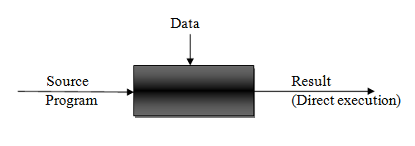
1) Interpreter
“An interpreter is a kind of translator which produces the result directly when the source language and data is given to it as input”.
Interpreter

Slide 5
Benefits of Interpreter
It doesn’t generate target program.
It doesn’t involve code generation process, this simplicity makes interpretation of the program easy where we do not need to execute the commands or instructions repeatedly.
Thus, For the languages or program in which the commands are not executed repeatedly, interpreter is supposed to be a good choice.
Interpretation is a popular choice due to its easy and simple behavior.
Alteration of codes is possible during runtime.
Really useful for debugging the codes.

Slide 6
Overview of interpretation
Symbol table
Data store
Data manipulation routine
Symbol Table: The symbol table contains the information about entities in the source program. For example the information about the identifier is entered in the symbol table. This information can be type, memory location of the identifier.
Data store: The data store contains the value of the data item begin interpreted.
Data manipulation routine: These are method or routine that exists for every legal data manipulation action in the source language.

Slide 7
Pure and Impure Interpreter

Slide 8
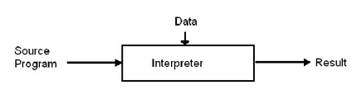
Pure Interpreter

Slide 9
Pure Interpreter
In a pure interpreter, the source program remains in the source form all through its interpretation.
Thus Pure interpreter is a kind of interpreter in which during the interpretation process itself the meaning of the source programming statement is obtained.
The pure interpreter has to perform lexical, syntax and semantic analysis of each statement before implementing its meaning.
This arrangement acquires large analysis overheads while interpreting a statement.

Slide 10
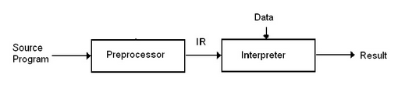
Impure Interpreter

Slide 11
Impure Interpreter
Impure interpreter is a kind of interpreter in which the preliminary processing of source program is done before interpretation.
The preliminary processing or preprocessing converts the source program into an intermediate representation.
The interpreter then uses this intermediate code instead of source program for interpretation.

Slide 12
Impure Interpreter
The impure interpreter reduces the overhead of analysis during the interpretation.
This speeds up interpretation as the code component of the IR i.e the IC, can be analyzed more efficiently than the source form of the program.

Slide 13
Java Language Environment

Slide 14
Java Language Environment
Java programs written in a text files with extension “.java”
applications are .java files with a main() method
compile a Java application
javac MyProgram.java
this will result in a file of Java byte code, MyProgram.class
run a Java application
java MyProgram
the Java virtual machine will execute the program in MyProgram.class

Slide 15
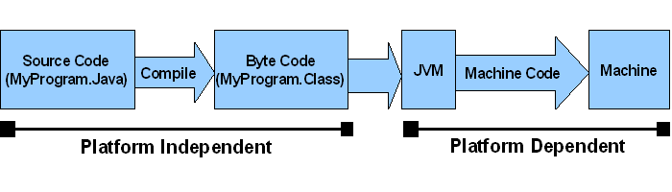
Bytecode Platform Independent vs JVM Platform Dependent
JVM is platform dependent that means there are different implementation of JVM on different OS.
Java code / Bytecode is always the same on different OS. That makes java program as platform independent.

Slide 16
JVM

Slide 17
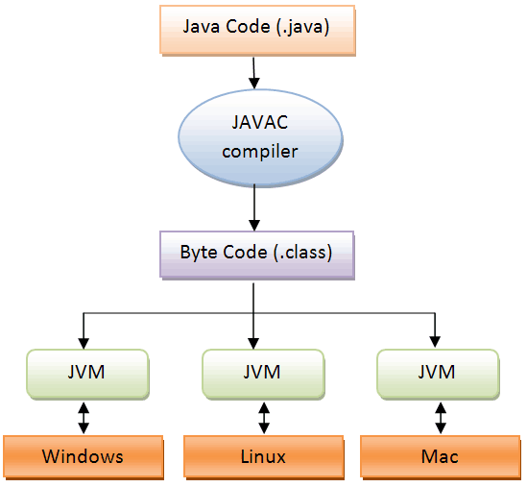
2) JVM

Slide 18
2) JVM
The heart of the Java platform is the concept of a "virtual machine" that executes Java bytecode programs.
This bytecode is the same no matter what hardware or operating system the program is running under.
There is a JIT compiler within the Java Virtual Machine, or JVM.
The JIT compiler translates the Java bytecode into native processor instructions at run-time and caches the native code in memory during execution.

Slide 19
2) JVM
The use of bytecode as an intermediate language permits Java programs to run on any platform that has a virtual machine available.
Although Java programs are platform independent, the code of the Java Virtual Machines (JVM) that execute these programs is not.
Every supported operating platform has its own JVM.

Slide 20
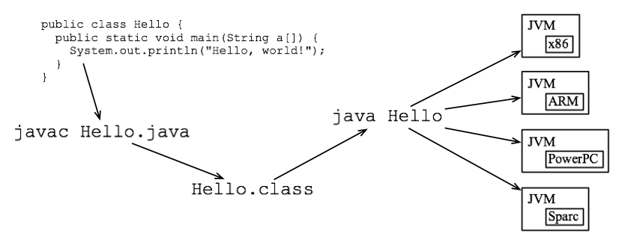
2) JVM

Slide 21
Debugging Procedures

Slide 22
Debugging Procedures
Whenever there is a gap between an expected output and an actual output of a program, the program needs to be debugged.
“An error in a program is called bug, and debugging means finding and removing the errors present in the program”.
Debugging involves executing the program in a controlled fashion.
During debugging, the execution of a program can be monitored at every step

Slide 23
Debugging Procedures
In the debug mode, activities such as starting the execution and stopping the execution are in the hands of the debugger.
The debugger provides the facility to execute a program up to the specified instruction by inserting a breakpoint.
It gives a chance to examine the values assigned to the variables present in the program at any instant and, if required, offers an opportunity to update the program.

Slide 24
Debugging Procedures
Types of debugging procedures:
Debug Monitors
Assertions

Slide 25
Debugging Procedures
Debug Monitors:
A debug monitor is a program that monitors the execution of a program and reports the state of a program during its execution.
It may interfere in the execution process, depending upon the actions carried out by a debugger (person).
In order to initiate the process of debugging, a programmer must compile the program with the debug option first.
This option, along with other information, generates a table that stores the information about the variables used in a program and their addresses.

Slide 26
Debugging Procedures
Assertions:
Assertions provide a useful debugging tool that allows you to have an assumption within your code and have this assumption checked automatically at run-time.
Every assertion includes a predicate, or Boolean condition, that you expect will always evaluate as true.
If the condition returns false, this means that the assumption is incorrect, possibly indicating that there is a bug in the code.
Rather than allowing the execution of the program to continue, the assertion is triggered and the code is paused to allow you to determine the cause of the problem.

Slide 27
Classification of Debuggers

Slide 28
Classification of Debuggers
Static debugging
Dynamic Debugging

Slide 29
Static Debugging
Static debugging focuses on semantic analysis.
In a certain program, suppose there are two variables: var1 and var2.
The type of var1 is an integer, and the type of var2 is a float.
Now, the program assigns the value of var2 to var1; then, there is a possibility that it may not get correctly assigned to the variable due to truncation.
This type of analysis falls under static debugging.
Static debugging detects errors before the actual execution.

Slide 30
Static Debugging
Static Debugging
Static code analysis may include detection of the following situations:
Dereferencing of variable before assigning a value to it
Truncation of value due to wrong assignment
Redeclaration of variables
Presence of unreachable code

Slide 31
Dynamic Debugger
Dynamic Debugger is also known as Interactive Debugger.
Dynamic analysis is carried out during program execution.
An interactive debugging system provides programmers with facilities that help in testing and debugging programs interactively.

Slide 32
Dynamic Debugger
A dynamic debugging system should provide the following facilities:
Execution sequencing
Breakpoints
Conditional expressions
Tracing
Traceback
Program-display capabilities

Slide 33
Dynamic Debugger
1) Execution sequencing
It is nothing but observation and control of the flow of program execution.
For example, the program may be halted after a fixed number of instructions are executed.
2) Breakpoints
Breakpoints specify the position within a program till which the program gets executed without disturbance.
Once the control reaches such a position, it allows the user to verify the contents of variables declared in the program.

Slide 34
Dynamic Debugger
3) Conditional expressions
A debugger can include statements in a program to ensure that certain conditions are reached in the program.
These statements, known as assertions, can be used to check whether some pre-condition or post-condition has been met in the program during execution.

Slide 35
Dynamic Debugger
4) Tracing
Tracing monitors step by step the execution of all executable statements present in a program.
The other name for this process is "step into".
Another possible variation is "step over" debugging that can be executed at the level of procedure or function.
This can be implemented by adding a breakpoint at the last executable statement in a program.

Slide 36
Dynamic Debugger
5) Traceback
This gives a user the chance to trace back over the functions, and the trace back utility uses stack data structure.
Traceback utility should show the path by which the current statement in the program was reached.
6) Program-display capabilities
While debugging is in progress, the program being debugged must be made visible on the screen along with the line numbers.

Slide 37
Ch – 8 Important Questions
What is interpreter? Explain benefits of interpreter.
Compare interpreter and compiler.
What is pure and impure interpreter?
Explain The Java Language Environment.
Explain JVM.
Explain Classification of Debuggers.

Slide 38
THANK YOU

